Slide 1
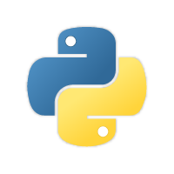
Natural Language Processing Course Setting up Your Environment
Ivo Bernardo – Udemy Course

Slide 2
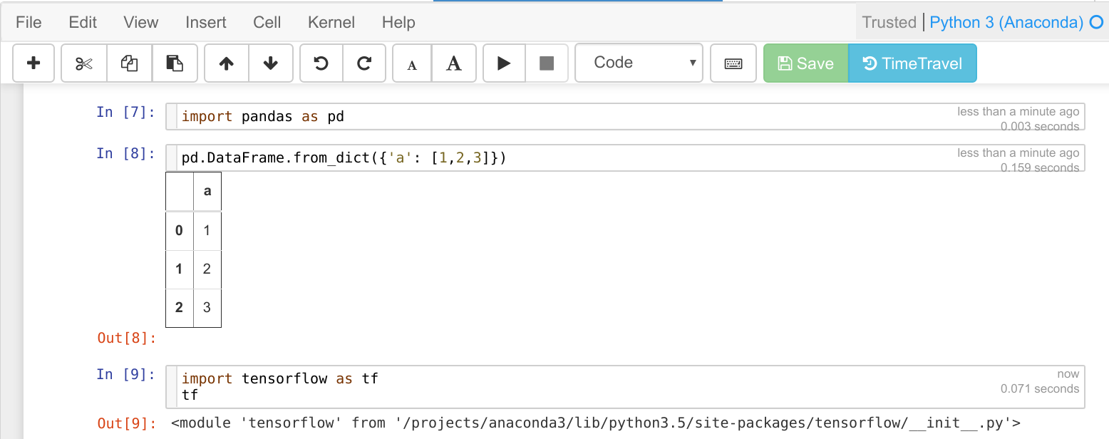

Setting up the Environment – Our IDE

Slide 3

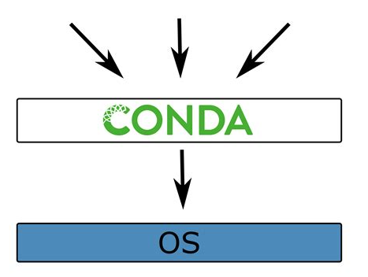
Setting up the Environment – Environments
Libs
Libs
Libs

Slide 4

Our Environment Manager

Slide 5


2 Alternatives to Create Your Environment
1) Importing my .env file
Libs
Examples of Libraries:
NLTK (Natural Language Toolkit)
Pandas (Tabular Data)
Numpy (Linear Algebra)
Keras and Tensorflow (Neural Networks

Slide 6


2 Alternatives to Create Your Environment
2) Creating your Env and Installing the Needed Libraries via Conda Navigator
Pandas
Numpy

Slide 7
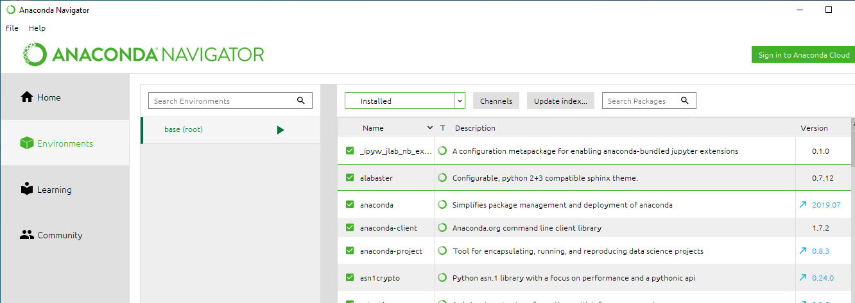
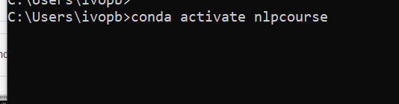

Work on the Environment:

Slide 8
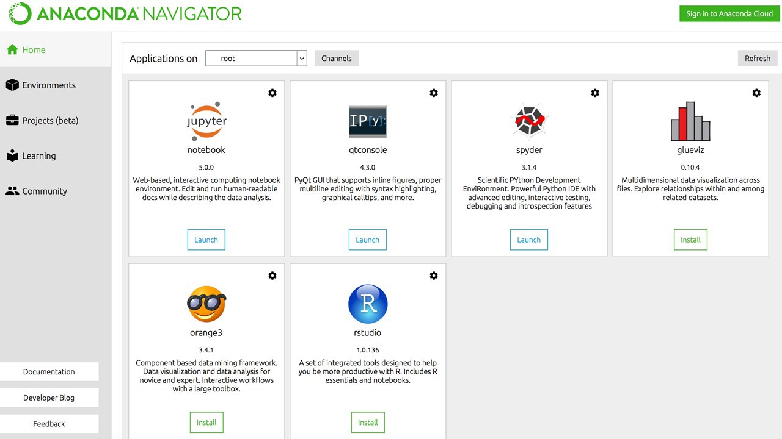
2 Ways to Launch Notebooks
1) Using the Anaconda Navigator

Slide 9
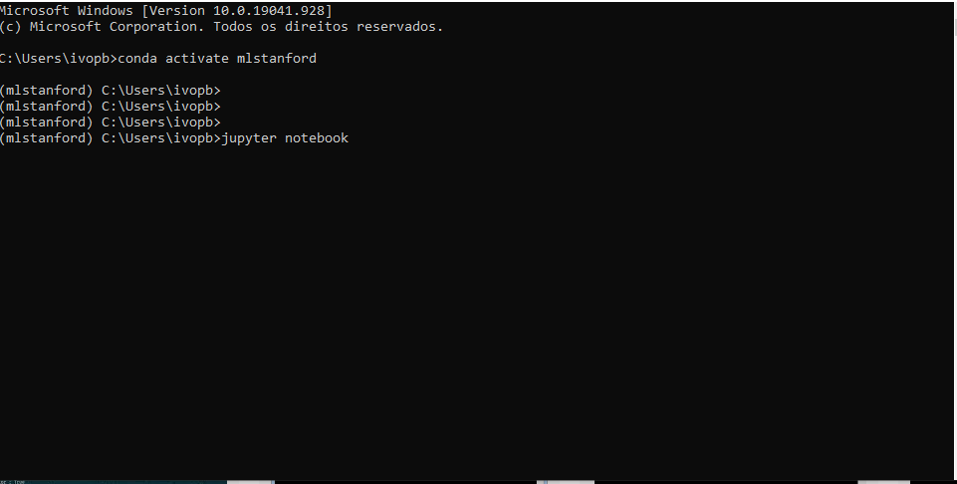
2 Ways to Launch Notebooks
2) Via Command Line

Slide 10
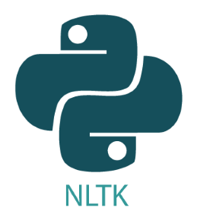


Testing your Environment
Install the Environment and
libraries
2) Activate the Environment
3) Launch Notebook
4) Import a installed Library
in the notebook

Slide 11

Alernative that does not Depend on Your System

